Slide 1
CSE 440
Artificial Intelligence
Knowledge Representation and Reasoning
Dr. Mohammad Mahmudul Alam
Department of Electrical & Computer Engineering (ECE)
North South University (NSU)

Slide 2
Introduction
Knowledge-based agents use reasoning over internal knowledge to decide actions.
Search algorithms know available actions and their outcomes but lack general facts.
Logic is developed as a general representation for knowledge-based agents.
Knowledge-based agents rely on structured internal knowledge for decision-making.
Knowledge-based agents differ from search algorithms by leveraging logical reasoning.

Slide 3
Topic Outline
We will explore the following key topics for logical agents:
The design of a Knowledge-Based Agents
Introduce a simple environment: The Wumpus World
Fundamental principles of logic: Propositional Logic (PL)
Canonical structured representation of logic: First-Order Logic (FOL)
Integrate knowledge-based agents with logic to build agents for the Wumpus World

Slide 4
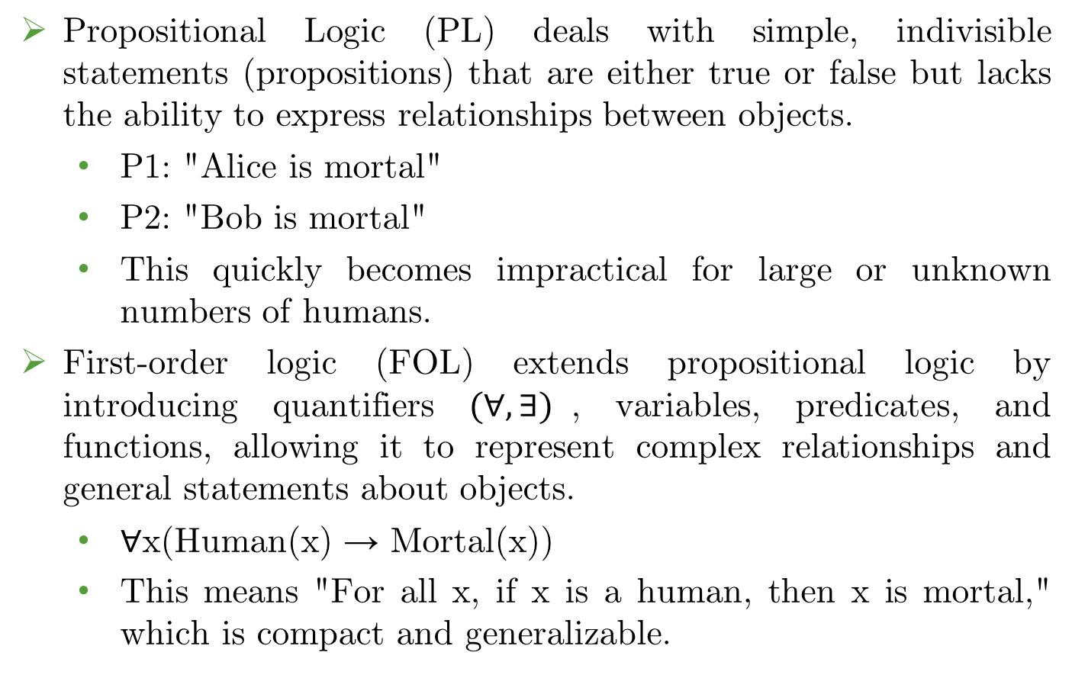
PL vs FOL
Propositional Logic (PL) deals with simple, indivisible statements (propositions) that are either true or false but lacks the ability to express relationships between objects.
  P1: "Alice is mortal"
  P2: "Bob is mortal"
  This quickly becomes impractical for large or unknown numbers of humans.
First-order logic (FOL) extends propositional logic by introducing quantifiers $(∀, ∃)$, variables, predicates, and functions, allowing it to represent complex relationships and general statements about objects.
  ∀x(Human(x) → Mortal(x))
  This means "For all x, if x is a human, then x is mortal," which is compact and generalizable.

Slide 5
Knowledge-Based Agents
A knowledge-based agent includes (at least) a Knowledge Base (KB) & an Inference System.
Knowledge Base:
  A knowledge base (KB) represents facts about the world.
  Each fact is a sentence or assertion.
  A sentence given without derivation is called an axiom.
Inference:
  We derive new sentences from old.
New sentences can be added to the knowledge base (TELL).
Queries can be made to retrieve known information (ASK).

Slide 6
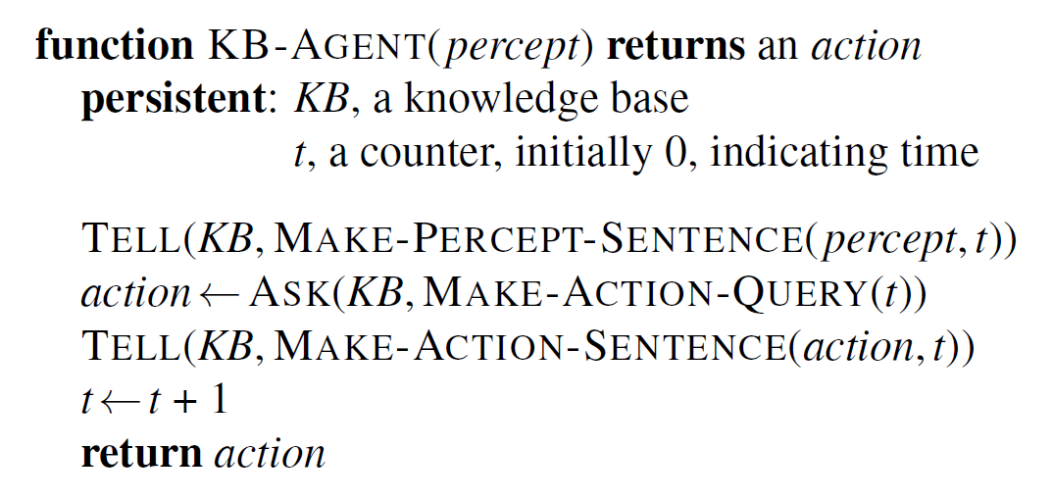
Knowledge-Based Agents
A knowledge-based agent operates as follows:
TELLs the knowledge base what it perceives.
  "asserts" knowledge into the KB.
ASKs the knowledge base what action to perform.
  performs "inference".

Slide 7
Knowledge-Based Agents
A knowledge-based agent is built by TELLing it what it needs to know.
The declarative approach involves adding knowledge step by step until the agent can operate.
Represent knowledge and let the agent infer actions, e.g., "If it’s raining, the ground gets wet." The agent can infer what to do when it knows it’s raining.
The procedural approach encodes behavior directly as program code, e.g., provide explicit instruction "If it’s raining, then execute action: stay inside."
In the past, debates occurred between declarative and procedural approaches.
Modern agents often combine both approaches for efficiency.

Slide 8

The Wumpus World

Slide 9
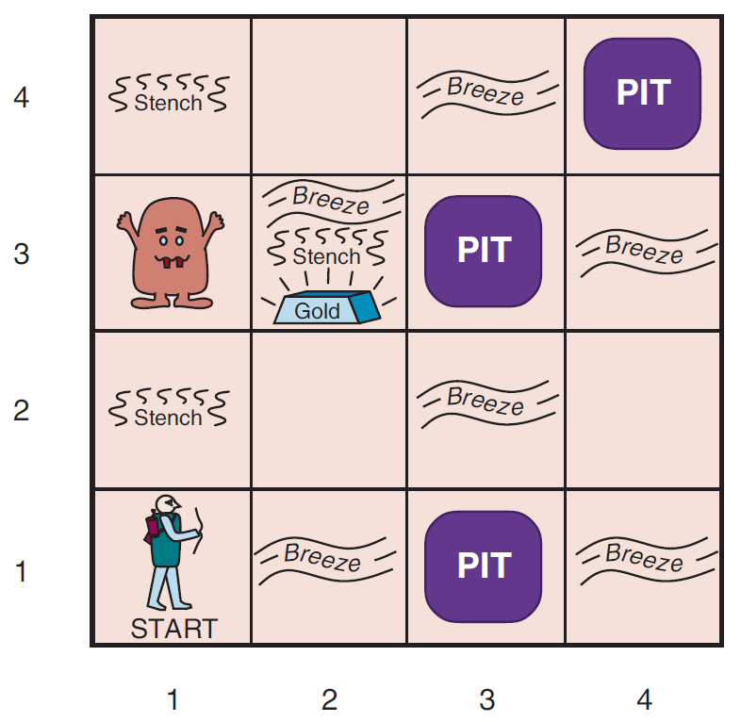
The Wumpus World

Slide 10
Wumpus World: Description
The Wumpus World is a cave with rooms connected by passageways.
A dangerous Wumpus lurks in the cave and eats anyone who enters its room.
The agent can shoot the Wumpus, but it has only one arrow.
Some rooms contain bottomless pits that trap anyone except the Wumpus.
The only reward in this world is the chance to find a heap of gold.

Slide 11
Wumpus World: Environment
Squares adjacent to Wumpus are smelly.
Squares adjacent to pit are breezy.
Glitter if and only if gold is in the same square.
Shooting kills the Wumpus if you are facing it.
Shooting uses up the only arrow.
Grabbing picks up the gold if in the same square.
Releasing drops the gold in the same square.

Slide 12
Wumpus World: Goal
Agent’s goal:
Find the gold
Bring it back to the start square as quickly as possible
Don’t get killed
Scoring:
1000 points reward for climbing out with the gold.
1 point deducted for every action taken.
1000 points penalty for getting killed.
Principle Difficulty: Agent is initially ignorant of the world, need to reason to figure out where the gold is without getting killed!

Slide 13
Wumpus World: PEAS
Performance Measure:
Environment:
Actuators:
Sensors:

Slide 14
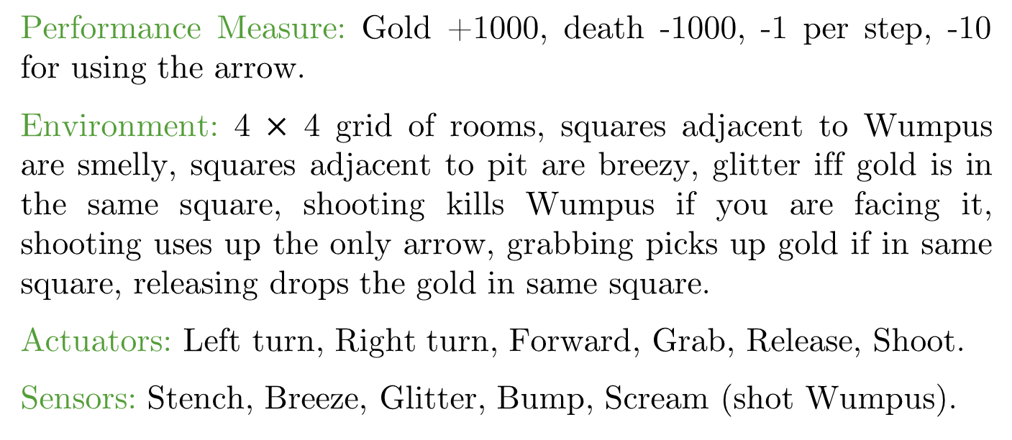
Wumpus World: PEAS
Performance Measure: Gold +1000, death -1000, -1 per step, -10 for using the arrow.
Environment: 4 $×$ 4 grid of rooms, squares adjacent to Wumpus are smelly, squares adjacent to pit are breezy, glitter iff gold is in the same square, shooting kills Wumpus if you are facing it, shooting uses up the only arrow, grabbing picks up gold if in same square, releasing drops the gold in same square.
Actuators: Left turn, Right turn, Forward, Grab, Release, Shoot.
Sensors: Stench, Breeze, Glitter, Bump, Scream (shot Wumpus).

Slide 15
Wumpus World: Environment Characteristics
Observable/ Partially Observable | Deterministic/ Stochastic | Static/ Dynamic | Discrete/ Continuous | Episodic/ Sequential | Single-agent/ Multi-agent
Partially Observable | Deterministic | Static | Discrete | Sequential | Single-agent

Slide 16
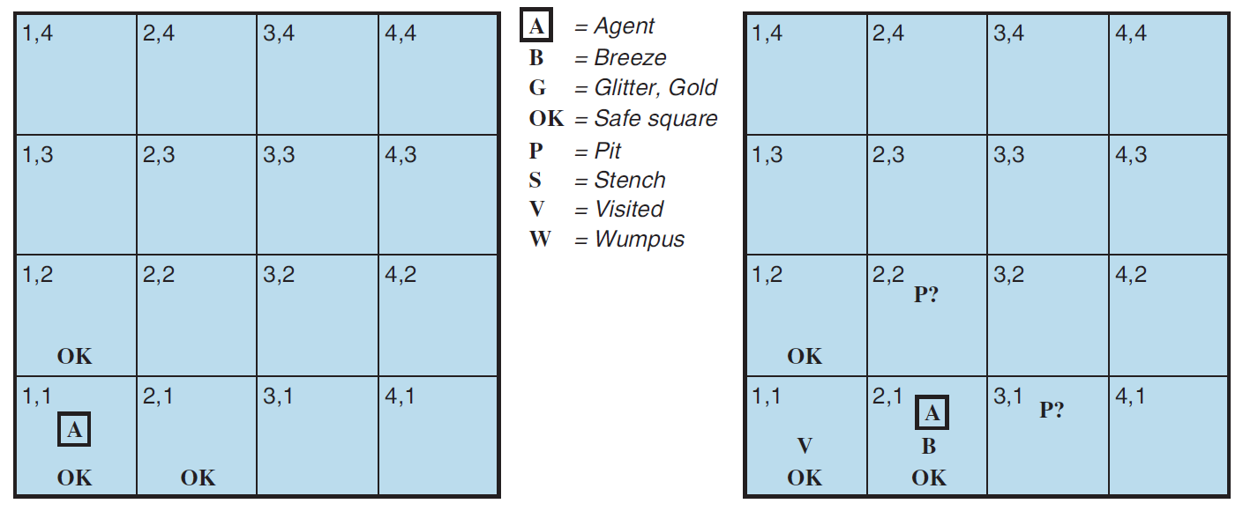
Exploring A Wumpus World
Online: https://luka1199.github.io/wumpus-world/

Slide 17
Logical Representation
Fundamental property of logical reasoning:
In each case where a conclusion is drawn from the available information, that conclusion is guaranteed to be correct if the available information is correct.

Slide 18
Logical Representation
Fundamental concepts of logical representation:
Logics are formal languages for representing information such that conclusions can be drawn.
Knowledge bases consist of sentences.
Each sentence is defined by a syntax and a semantic.
Syntax defines how symbols can be put together to form the sentences in the language.
Semantics define the “meaning” of sentences, i.e., in logic it defines the truth of a sentence in a possible world.

Slide 19
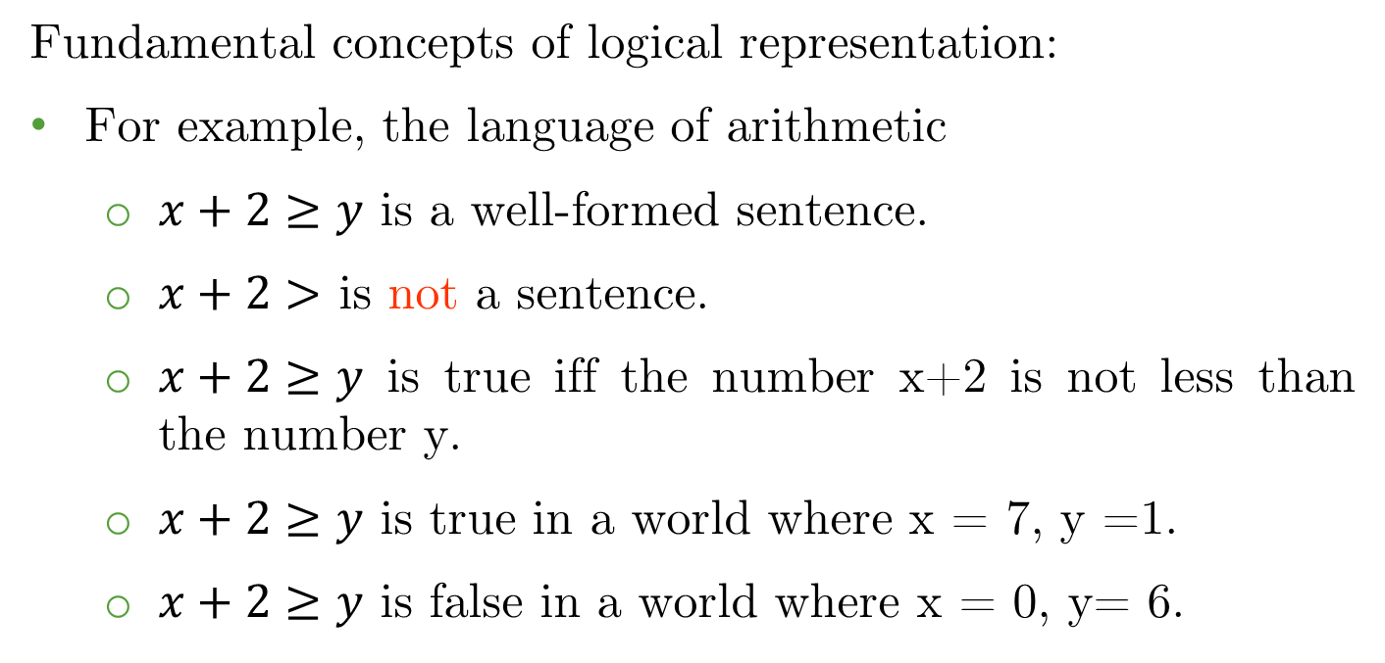
Logical Representation
Fundamental concepts of logical representation:
For example, the language of arithmetic
  $x+2≥y$ is a well-formed sentence.
  $x+2>$ is not a sentence.
  $x+2≥y$ is true iff the number x+2 is not less than the number y.
  $x+2≥y$ is true in a world where x = 7, y =1.
  $x+2≥y$ is false in a world where x = 0, y= 6.

Slide 20
Logical Representation
A “possible world” refers to a hypothetical way the world could be, given the agent's knowledge.
It represents one configuration of facts that might be true based on the available information.
The agent considers multiple possible worlds to reason under uncertainty and make decisions.
For example, if an agent knows "There is either gold in room A or room B, but not both" then there are two possible worlds:
  Gold in room A, not in B
  Gold in room B, not in A
By exploring and gathering information, the agent identifies the true state of the world.

Slide 21
Logical Representation
The term "model" is used instead of "possible world" to be more precise.
Definition: A model is a mathematical abstraction that determines the truth or falsehood of every relevant sentence.
If m is a model of a sentence α, then α is true in m.
Alternatively, if α is true in m, then we say m satisfies α, meaning m is a model of α.

Slide 22
Logical Representation
Example: x number of men and y number of women sitting at a table playing game.
x + y = 4 is a sentence which is true when the total number is four.
Model: possible assignment of numbers to the variables x and y. Each assignment fixes the truth of any sentence whose variables are x and y.
Model for x + y = 4: (x, y) = {(0,4),(4,0),(3,1),(1,3),(2,2)}

Slide 23
Entailment
Entailment: Logical reasoning requires the relation of logical entailment between sentences: “a sentence follows logically from another sentence”.
Mathematical notation: α╞ β
(α entails the sentence β)
Formal definition: α╞ β if and only if in every model in which α is true, β is also true. (truth of β is contained in the truth of α).

Slide 24
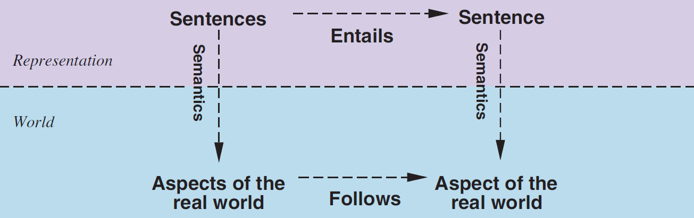
Relation Between Sentences and Facts
Ex. If it rains outside, then the ground is wet.
Semantics map sentences in logic to facts in the world.
The property of one fact following from another is mirrored by the property of one sentence being entailed by another.

Slide 25
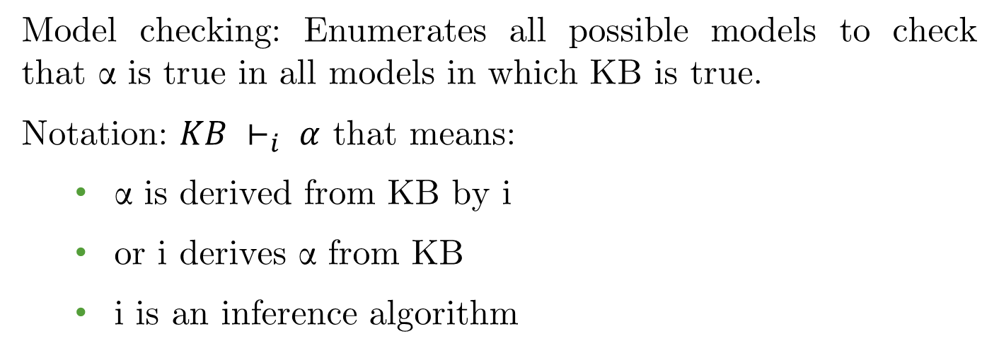
Model Checking
Model checking: Enumerates all possible models to check that α is true in all models in which KB is true.
Notation: $KB ⊢_{i} α$ that means:
  α is derived from KB by i
  or i derives α from KB
  i is an inference algorithm

Slide 26
Soundness & Completeness
Soundness: An inference procedure is sound if it derives only sentences that are actually entailed by the knowledge base (KB). This ensures that no false conclusions are made.
  Example: If KB states, "All humans are mortal" and "Socrates is a human," a sound inference procedure can derive "Socrates is mortal" but will never derive "Socrates is immortal".
Completeness: An inference procedure is complete if it can derive every sentence that is entailed by the KB. This means it finds all true conclusions.
  Example: If KB entails "Socrates is mortal," a complete inference system will always be able to derive it. If it fails to do so, it is incomplete.

Slide 27
Summary
Intelligent agents need knowledge about the world for making good decisions.
The knowledge of an agent is stored in knowledge base (KB) in the form of sentences in a knowledge representation language.
A knowledge-based agent needs a knowledge base (KB) and an inference mechanism.
It operates by storing sentences in its knowledge base, inferring new sentences with the inference mechanism and using them to deduce which actions to take.
A representation language is defined by its syntax and semantics, which specify structure of sentences and how they relate to world facts.
The interpretation of a sentence is the fact to which it refers. If this fact is part of the actual world, then the sentence is true.

Slide 28
Reading
Chapter 07 of the textbook
Pages: 226 - 234

